Slide 1
Air Pollution and Socio-Economic Profile
Will Chan
Notes:
Project that I have been working on this semester

Slide 2
Outline
Overview
Motivation
Data collection
Data Preparation
Exploratory Data Analysis
Data Processing
Modeling
Evaluation
Limitation and Challenges
Notes:
Outline of what im going to talk about

Slide 3
Project/Abstract (General Overview)
200 US Counties
Predict annual air pollution (PM10) 2019
Socio Economic factors 2017-2019
County demographics
Poverty + Income levels
Unemployment + Emloyment rate
Education attainment levels
Vehicle totals
Notes:
What my project is about

Slide 4
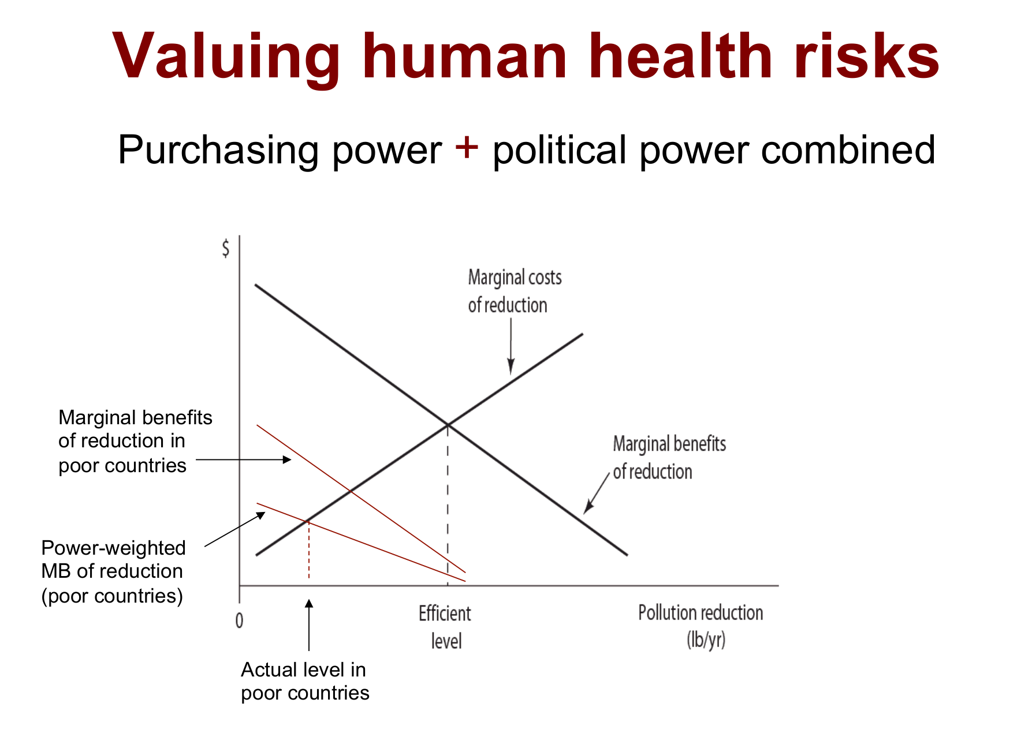
Project/Abstract (motivation)
Econ 308 (Political Economy of the Environment)
Power-weighted social decision rule
Notes:
Basically a graph that encapsulates how more powerful and developed countries perceive efficiency in polluting ot less powerful countries
This formulates something known as the Power weighted social decision rule, which states
- How more powerful sociopolitical groups are less impacted by negatives externalities (environment + health)
Than less powerful groups; which means that socio political factors should dictate whether a groupw ill ahve les environment protections or increased levels of environmental such as air quality
Lawrence Summers was the chief economist of the world bank at the time adn this is the memo he stated was drafted in his office by a staff member and he had signed it; after it was leaked in the economist he stated it was intended to be sarcastic only after it was leaked in the economist (pritchett, someone who work for him worte it and summers had signed it)
Saying how dumping toxic waste in third world countries was advised for economic benefits
Summarizing his 3 arguments
Health impair pollution should take place in areas where it will have lower cost (less developed countries valued less → lowest wages, lowest life expectancy, )
Saying its a lot cheaper to and lower cost to pollute in less developed countries and because of this they should be polluted more
People in devleoped countries with greater life expectancy and income will live long enough to be experience and be impacted by pollution and thus be more concerned with aesthetics of the environment and the potential for health risks, rather than less developed countries who have a higher mortality rate and die from less pollution causes like starvation or crime

Slide 5
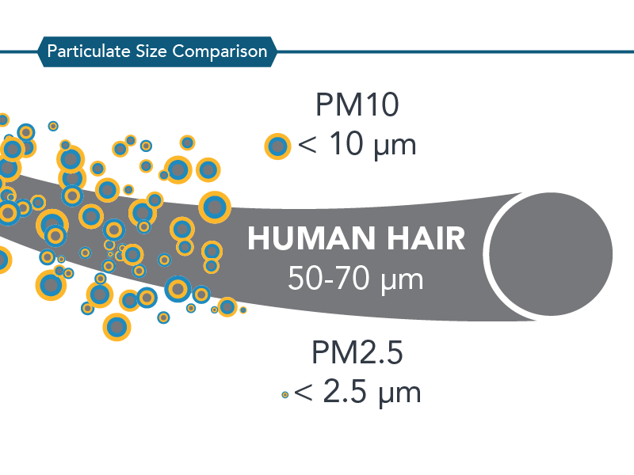
Project/Abstract (PM10 dangers)
Airborne particulate matter (mixture of many chemical species)
complex mixture of solids and aerosols composed of small droplets of liquid, dry solid fragments, and solid cores with liquid coatings
Particles are defined by their diameter for air quality regulatory purposes.
(PM10) are inhalable into the lungs and can induce adverse health effects
Respiratory (heart + lung) damage
Environmental Impact
Reduce Visibility
Metal and organic compounds alter plant growth + yield
Soiling of materials
Impact water quality and clarity
PM10 can be emitted by both natural sources, such as trees and vegetation, as well as from man-made (anthropogenic) sources, such as industrial processes and motor vehicle exhaust
Notes:
Respiratory problems (primarily damages heart and lung tissues)
PM10 and PM2.5 often derive from different emissions sources, and also have different chemical compositions. Emissions from combustion of gasoline, oil, diesel fuel or wood produce much of the PM2.5 pollution found in outdoor air, as well as a significant proportion of PM10. PM10 also includes dust from construction sites, landfills and agriculture, wildfires and brush/waste burning, industrial sources, wind-blown dust from open lands, pollen and fragments of bacteria.
Reduce visibility of light with altering how light is absorbed and scattered in atmosphere (problem for plants as well the compounds affterct it)
https://ww2.arb.ca.gov/resources/inhalable-particulate-matter-and-health

Slide 6
Data
Epa.gov
Daily PM10 AQI
Air Quality System (AQS) monitors
Data.census.gov
County Characteristics Resident Population Estimates
Age, Sex, and Race
SAIPE (Small Area Income and Poverty Estimates Program)
Poverty, Median Household Incomes
ACS1 American Community Survey)
Education attainment levels
Total Vehicles
Notes:
AQS is the system that is used to measure AQI for an area; the system uses monitors that collect samples and particles in the area
County Characterists estimation is data extracted from the US census bears population division: labelled to include these metrics
SAIPE is a program that gathers data and makes estimates for income and poverty in small areas
ACS1 is a survey and this was retrieved from the Data Census API to get this specific data

Slide 7
Data (cont.)
Data.ers.usda.gov
Economic Research Service
County Unemployment and Median Household Incomes
Civilian Labor Force, Employed, Unemployed, Unemployment rate
Bea.gov
Bureau of Economics Analysis
County Annual Income (CAINC1):
County Personal Income, Population, Per Capita Personal Income
Notes:
Data.ers.usda.gov sources their data from
U.S. Department of Labor, Bureau of Labor Statistics, Local Area Unemployment Statistics (LAUS); median household income: U.S. Department of Commerce, Bureau of the Census, Small Area Income and Poverty Estimates (SAIPE) Program.

Slide 8
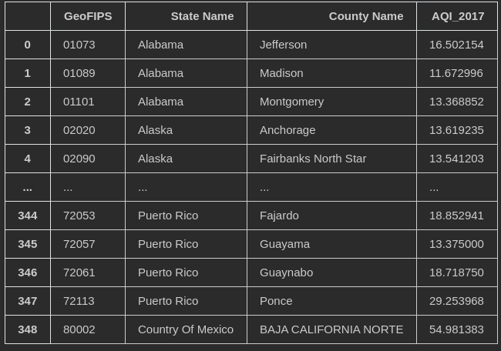
Data Preparation
PM10 Daily Data → PM10 Annual Data
16000 observations → 340 observations
Merge 2017 - 2019 data
Merge other datasets
GeoFIPS
Overall columns: AQI, Civilian labor force,
Employment/Unemployment, Poverty
Education Attainment Levels
Vehicle Totals
County Characteristics
Data loss
340 observations → 208 observations
Each year 567 columns
Notes:
Because Frequency of majority of my data were all Annualy or by year; except for AQI which was daily I had to transform AQI from daily to annually and lost observations because of it
Each annual Air Qaulity Index dataset ahd around 16k observation and I reduced it to yearly
So instead of daily aqi for each county per year, we have annual mean aqi for that county, but reduce our data to 340 observations
Merge all dataset, (we merge on a created column GeoFIPS) which is we the county and state label
Columns we have averaged annual PM10 per county,
Employment pop, Unemployment pop, Unemployment rate, poverty population (groups considered to be in poverty) also poverty brackets, etc..
but because not all datasets have equal number of counties we lose some column and result with 208 observations

Slide 9
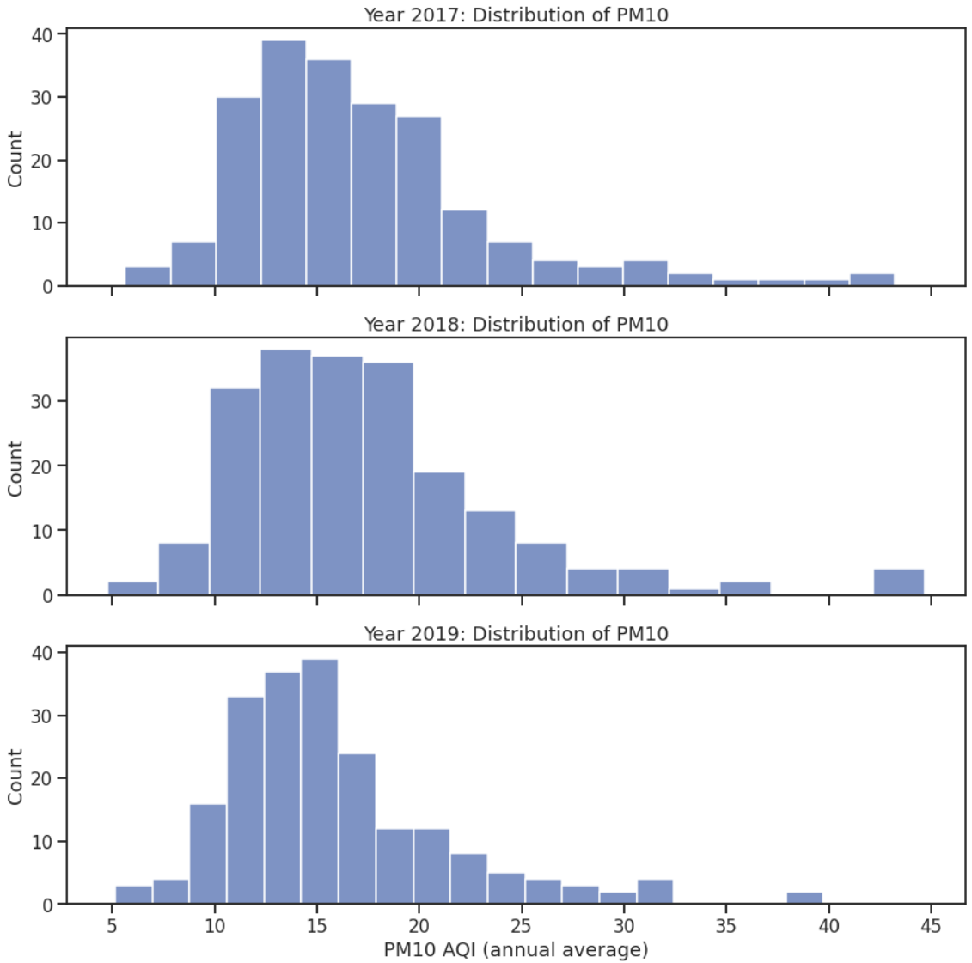
Exploratory Data Analysis
Distribution of Annual PM10 levels from 2017-2019
Majority of PM10 levels appear to range from 10-20 annually
Max is around 40
Min is around 5

Slide 10
Exploratory Data Analysis (county with largest and lowest AQI)
County w/ Largest Annual PM10 AQI
2017: California, Kings: 43.21
2018: California, Kings: 44.67
2019: California, Kings: 39.72
County w/ Smallest Annual PM10 AQI
2017: Massachusetts, Hampshire: 5.64
2018: Massachusetts, Hampshire: 4.76
2019: Vermont, Chittenden: 5.14

Slide 11
Exploratory Data Analysis (Hypothesis test)
Testing whether the top correlated attribute HWAC_MALE_ratio has an impact on PM10 levels of a county for year 2017
HO = On average, counties that have above average HWAC ratio will have about the same pm10 aqi as other counties with below ratios
HA = On average, counties with below or above average HWAC ratios will have significantly different levels of pm10 aqi
Perform a Two Sided T Test
T-Statistic = 5.344351656283399
p-value = 6.201321040496359e-07
Reject the null hypothesis and assume that on average there is a significant impact on county PM10 aqi levels when the ratio of HWAC individuals is above average, which is above 8.50% in our situation
Notes:
HWAC (0.56 positive) one of our top correlated features and represents Hispanic, White alone or in combination male population
Meaning the individual considers themselves as hispanic origin and also see themselves as either white or mixed race

Slide 12
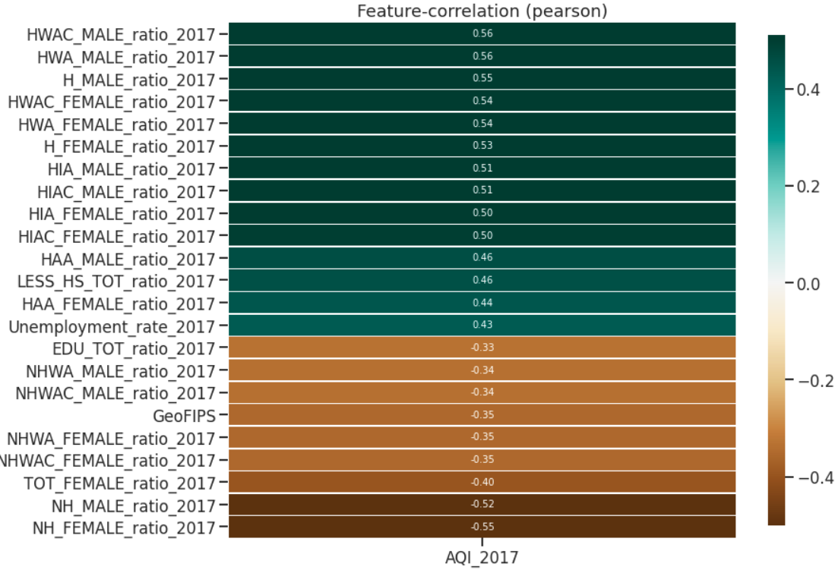
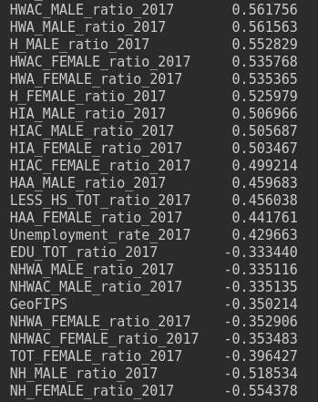
Exploratory Data Analysis (Correlation) 2017 Metrics on AQI_2017 target
Notes:
Pearson Moderately correlated appears with more hispanic communities; and communities that have less than high school attainment ratio in the community and also unemployment rate
Negative correlation is non hispanic communities,and having a high total of education attainment ratio (more ppl graduation with some education status)

Slide 13
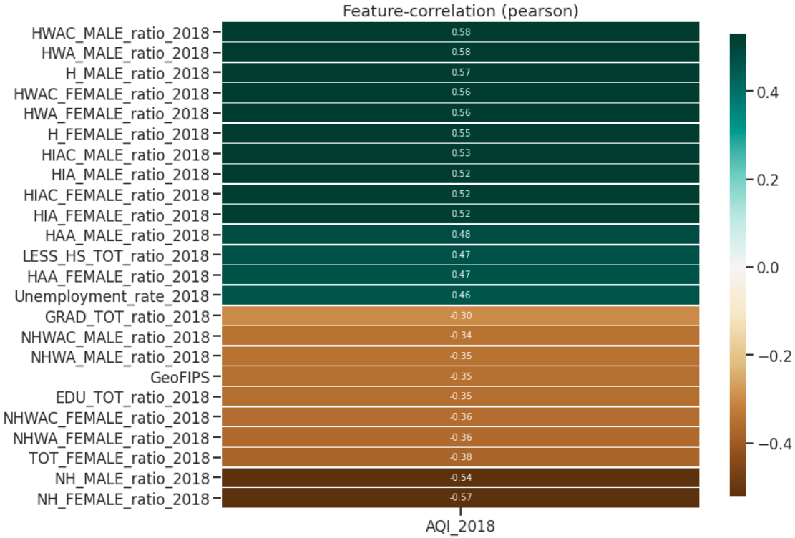
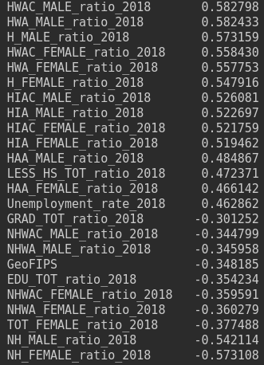
Correlation 2018 Metrics on AQI_2018 target
Notes:
Ordering values of correlation may be slightly different Same as last year

Slide 14
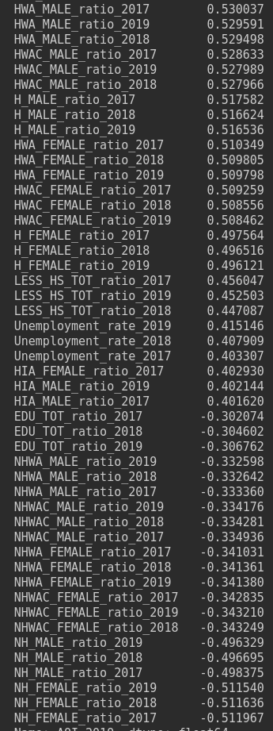
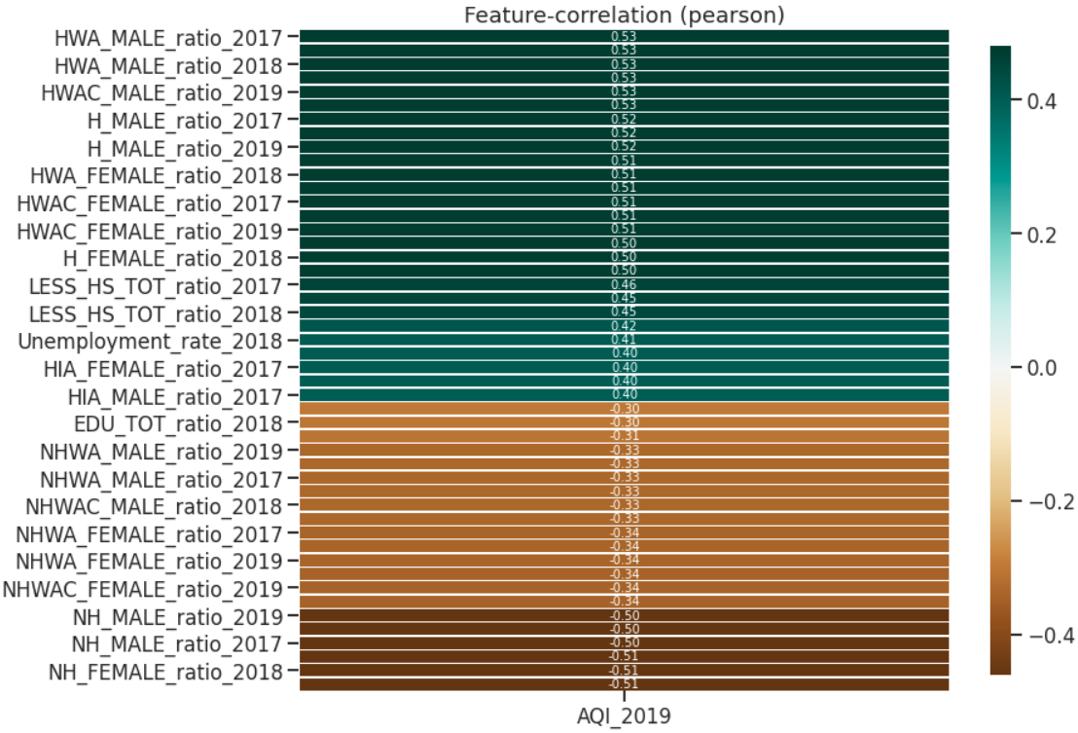
Correlation 2017-2019 metrics on AQI_2019 target
Notes:
This chart different ( as I want to predict mainly 2019 aqi i will look at all metrics from earlier and see how correlated it is)
Note the correlation plot does not display all the features from the correlated list on the right (it displays around 27 features) Where on the right we have 50 features
It basically speaks the same correlations of high hipsanic ratio communities,, less than high scool ratios, unemployment associate with more pollution, while non hispanic and more education totals result less
Meaning more educated communities or more non hispanic ratioed communities associate with cleaner air

Slide 15
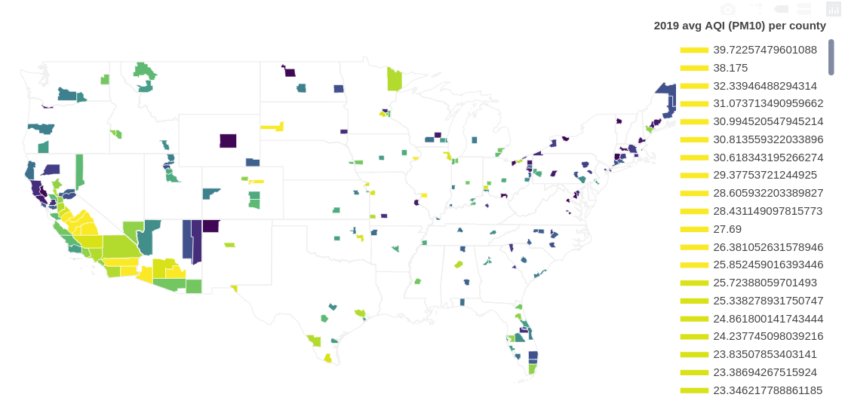
Notes:
Chorethplot mapping to show counties covered across the us for my study
208 counties
Choropleth map; showing counties and AQI levels associated with counties
Darker colors purple represent lower aqi levels (so cleaner) 10 or below
Lighter colors yellow represent higher aqi levels up to 40-30
Green represent middle range of AQI (30-15)

Slide 16
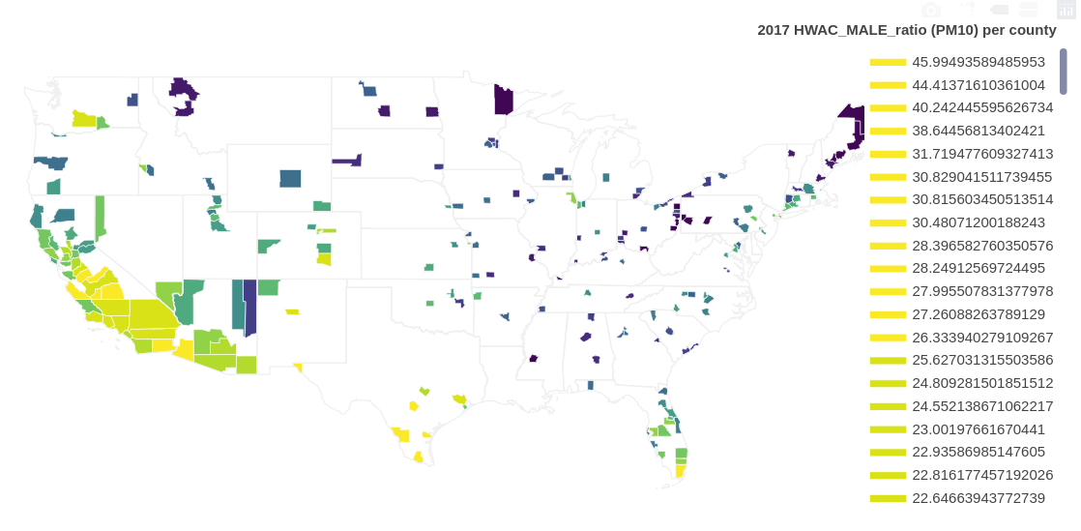
Notes:
One of the top correlated features with AQI-2019 also plotted on choropleth plot
Following the pattern, it appears that demographics that are abundant in Southern California counties and sparse in east coast of the US, will be strongly correlated to the PM10 levels.
From the two maps it can be seen that there is strong/moderate correlation as more HWAC ratios are prevalent in southern California and somewhat sparse in east coast.
This points race being correlated to pattern of pm10 levels

Slide 17
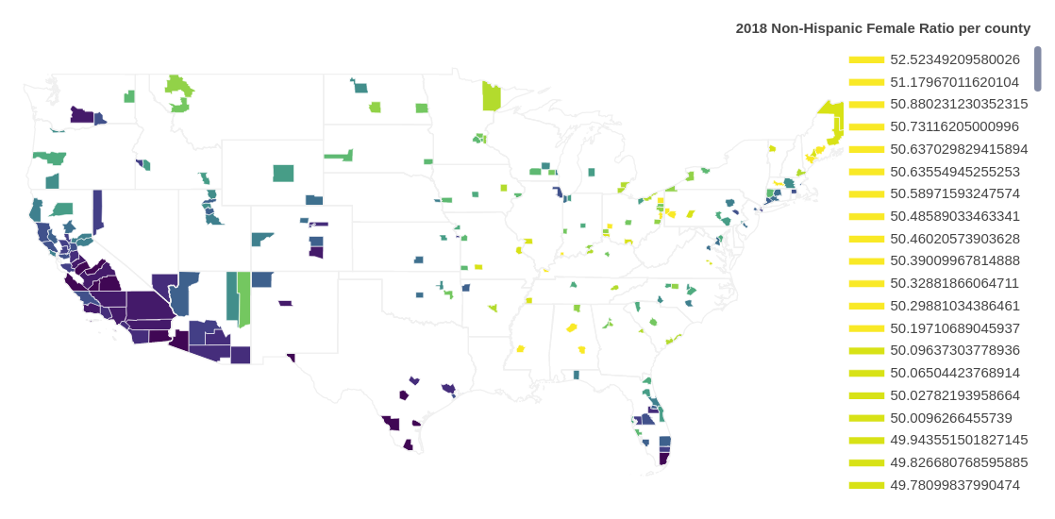
Notes:
Lowest correlated feature with AQI_2019
It appears that the lack of ratio for NH females per county is much more drastic in California 2018 data than in 2017 data where it only appeared that southern california counties were low, in 2018 it appears that all of California has low ratio NH females; also it appears there is an increase of ratio for NH females in NE states than observed in 2017 data

Slide 18
Pre-Processing
Stationarize Data
Scale Data
Use 2017-2019 features to predict 2019 PM10 AQI levels
Feature Engineering
Year Differences 2017-2018, 2017-2019, 2017-2018, 2018-2019
Percent Changes 2017-2018, 2017-2019, 2017-2018, 2018-2019
1311 Features

Slide 19
Modeling
Usages of Feature Selection
Hyperparameter Tuning
Built Models
Linear Regression
Random Forest Regressor
Gradient Boosting Regressor
Notes:
Usage of feature selection with select k best
And feature importannces
Hyper parameter tuning as well

Slide 20
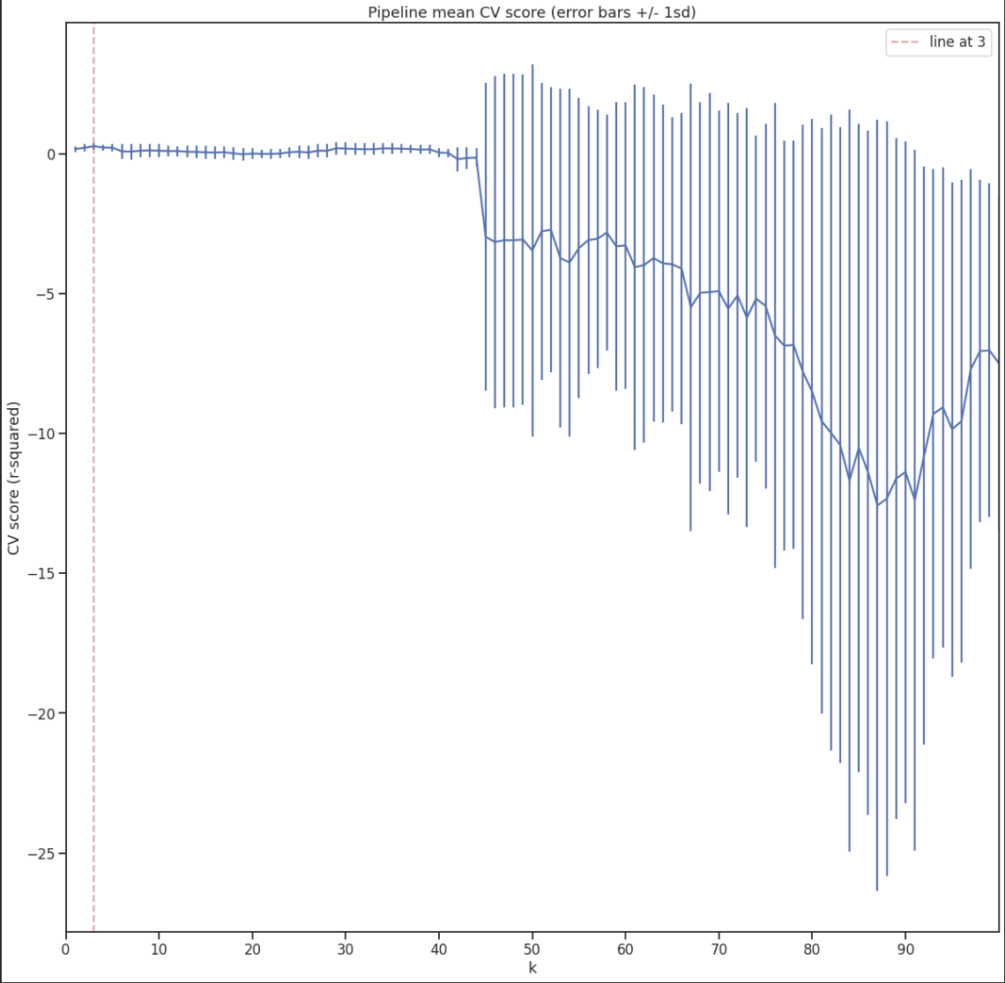
Modeling (cont.)
Linear Regression Model
K-Best Features
Results dip > 40
3 K Best Feaures
Local maxima
Low train std dev
Notes:
Usage of feature selection with select k best
And feature importannces
Hyper parameter tuning as well

Slide 21
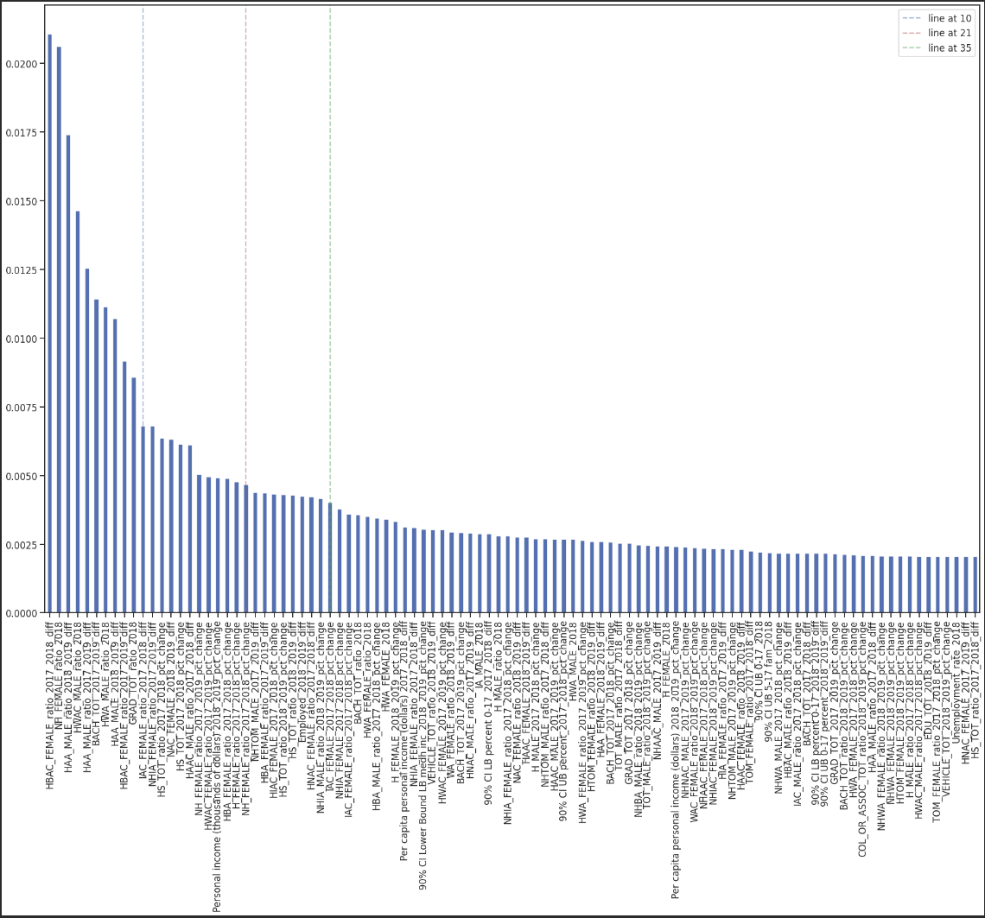
Modeling (cont.)
Random Forest Regressor
Feature Importance
21-35 Features
Notes:
Usage of feature selection with select k best
And feature importannces
Hyper parameter tuning as well

Slide 22
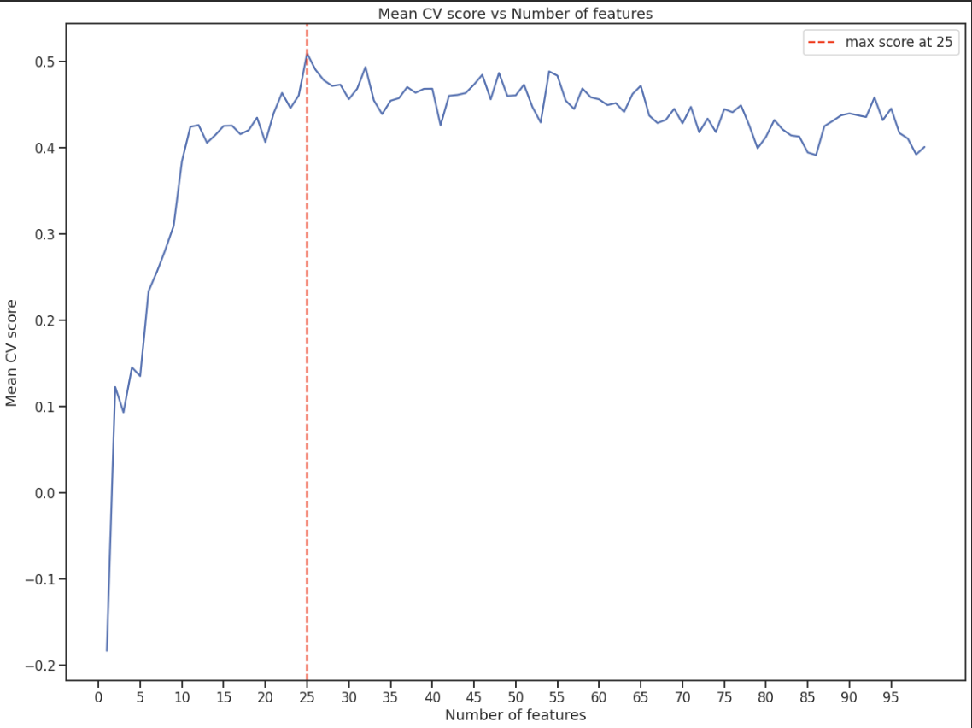
Modeling (cont.)
Gradient Boosting Regressor
Feature Importance
25 Features
Notes:
Usage of feature selection with select k best
And feature importannces
Hyper parameter tuning as well

Slide 23
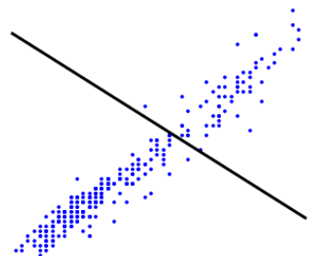
Baseline (Dummy Regressors)
Dummy Regressor w/ Mean Strategy
Train MAE mean: 4.002, Train Std 0.537
Test MAE mean:4.224
Train R² : -0.0199, Train Std 0.016
Test R² : -0.0147
Dummy Regressor w/ Median Strategy
Train MAE mean: 3.919, Train Std 0.491
Test MAE mean:3.966
Train R² : -0.0563, Train Std 0.077
Test R² : -0.006
Notes:
Dummy Regressor used as baselines to compare with our models
With looking at mean and median of our target aqi_2019 as its strategy
Note train score and std were from cross validation
A negative correlation of determination is really bad

Slide 24
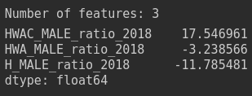
Linear Regression Model
Evaluation Metrics
Train MAE mean: 3.525, Train Std 0.479
Test MAE mean:3.182
Train R² : 0.265, Train Std 0.118
Test R² : 0.406

Slide 25
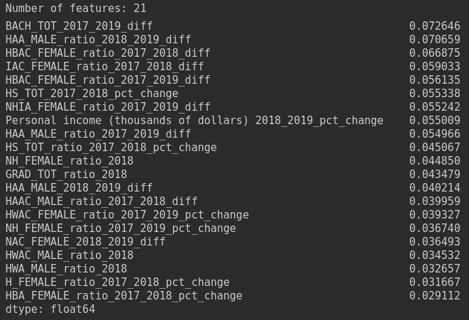
Random Forest Regressor
Evaluation Metrics
Train MAE mean: 2.993, Train Std 0.466
Test MAE mean: 3.512
Train R² : 0.407, Train Std 0.166
Test R² : 0.404
Notes:
Also note random forest regressor performs better without scaler
RF uses feature importance

Slide 26
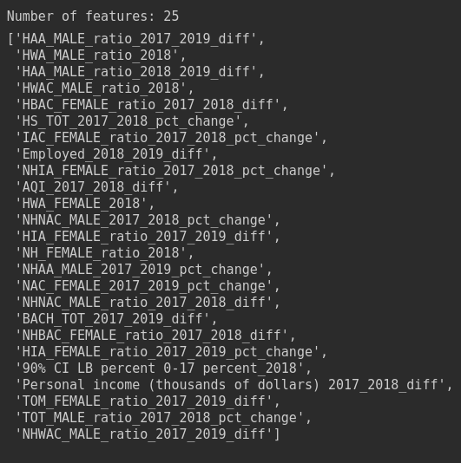
Gradient Boosting Regressor
Evaluation Metrics
Train MAE mean: 2.957, Train Std 0.457
Test MAE mean: 3.329
Train R² : 0.4437, Train Std 0.018
Test R² : 0.4436

Slide 27
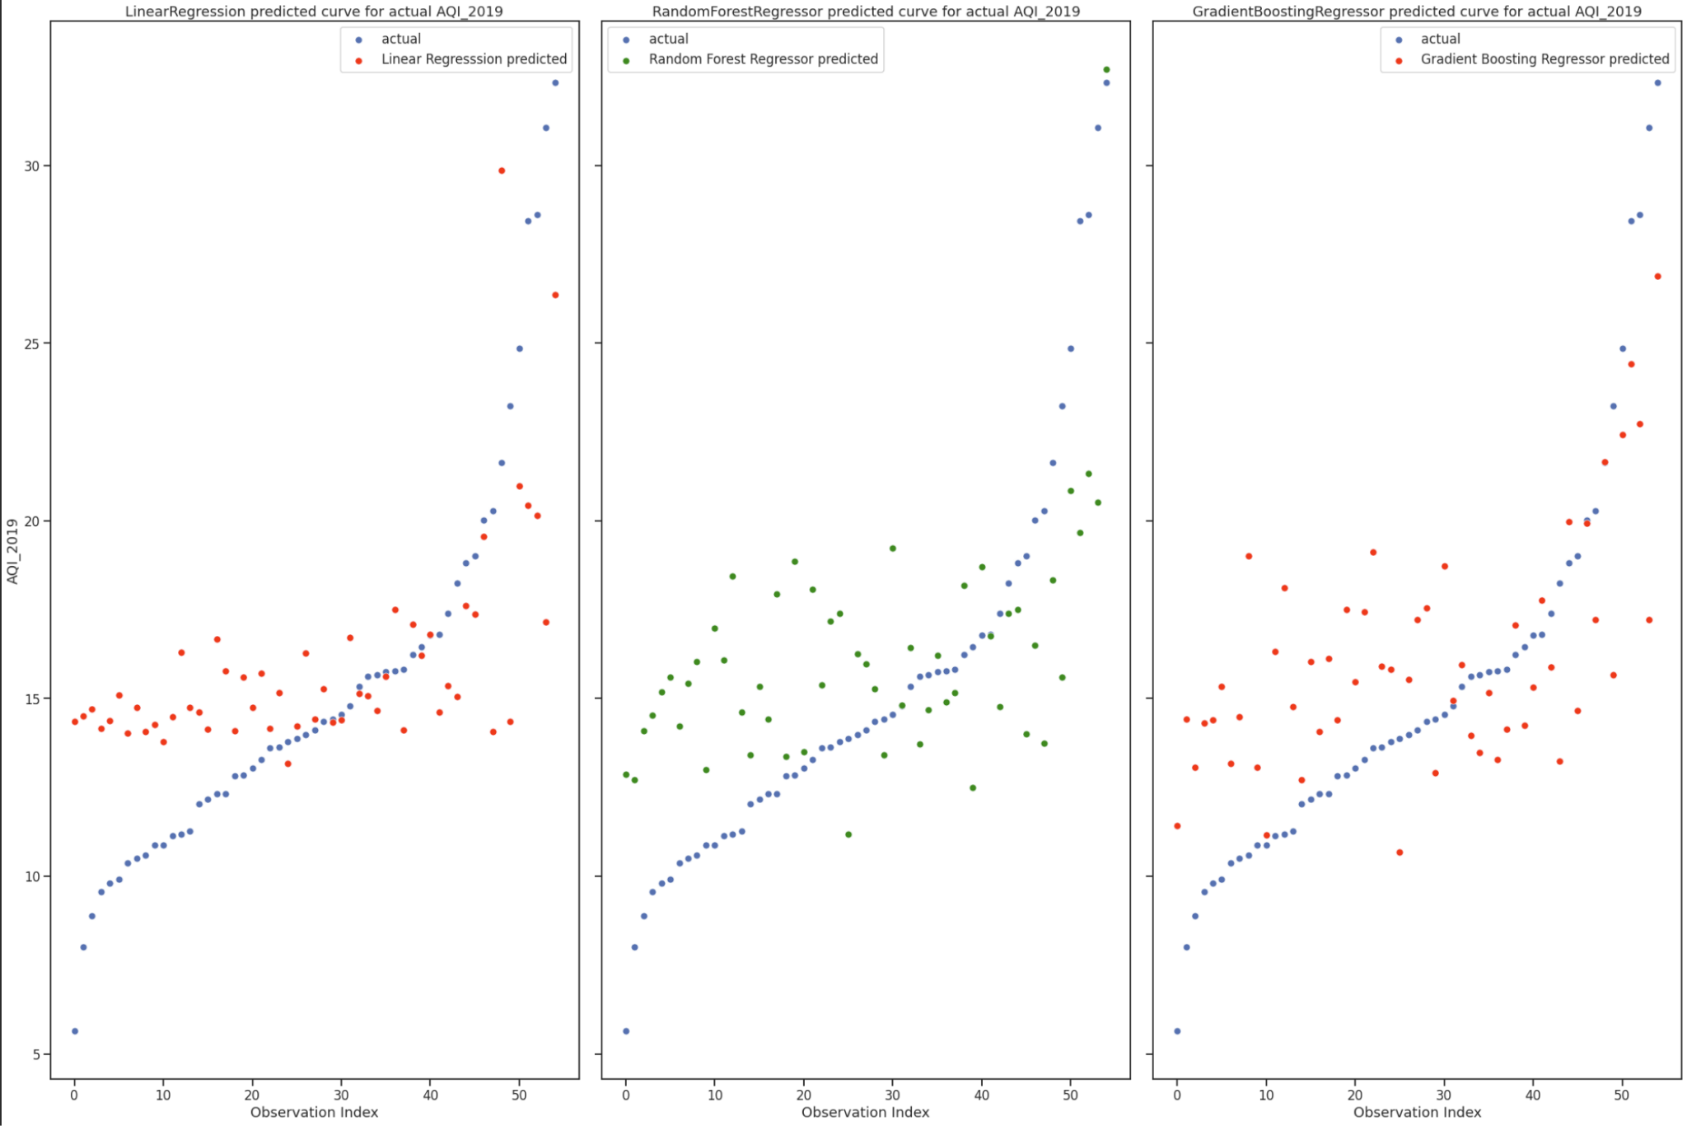
Evaluation
Linear Regression more simple
3 features
Similar Score
More Variable
Random Forest Regressor
21 features
Similar Score
Less bias and Less Variance
Gradient Boosting Regressor
25 features
Largest Score
Comparison with Dummies
R^2 of 0.4 is weak but in comparison to Baseline is significant improvement
Both models significantly outperform Dummy Regressors

Slide 29
Limitations + Challenges + Future improvements
Low number of observations (Big P Little N)
1311 > 208
Feature Engineering
Domain Knowledge
More models

Slide 30
Potential Insights
Property valuation
Environmental Protection Agencies
Construction and Industrial organizations
Notes:
May be good for property valuation over time, sites with highly associated socio economic factors with pollution may be valued less in future
Helpful for epa in choosing areas to focus more and areas to focus less (also sites where to place more monitors perhaps)
Sites are most likely more polluted for other reasons such as less resistance and concern from community or overall less environmental protection so these orgz can take advantage of polluting for less cost

